Slide 1
Capstone Project - The Battle of Neighborhoods
A Study of Neighborhoods of Overland Park

Slide 2
Overview
Introduction
Data
Methodology
Results
Discussion
Conclusion
Future Study
References and Resources
Acknowledgement
Q&A

Slide 3
Introduction
Question:
Why Overland Park shows up frequently on the top list of best places to live in US?
Who May Benefit From This Study?
Local business on recruiting marketing to attract more talents to Overland Park
People who want to find a better place to retire or to raise a family to make informed decision
Myself to know my community better

Slide 4
Data
Data Sources
Data Wrangling

Slide 5
Data Sources
Nextdoor website: list of neighborhoods in Overland Park
geopy library to get the latitude and longitude values of the neighborhoods

Slide 6
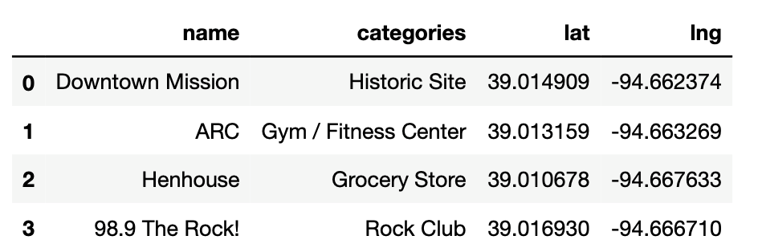
Data Sources (Continued)
Foursquare: location data such as data describing places and venues

Slide 7
Data Wrangling
Added “ Overland Park, Kansas” to the neighborhood names as addresses and got back reasonable geo coordinates
Limit the analysis on only the neighborhoods with geo coordinates returned
Combined neighborhoods data with Foursquare data and built a dataframe of neighborhoods with their top 10 most common venues in their respective neighborhood, ready for segmentation and clustering analysis.

Slide 8
Methodology
Exploratory Data Analysis
K-means Cluster

Slide 9
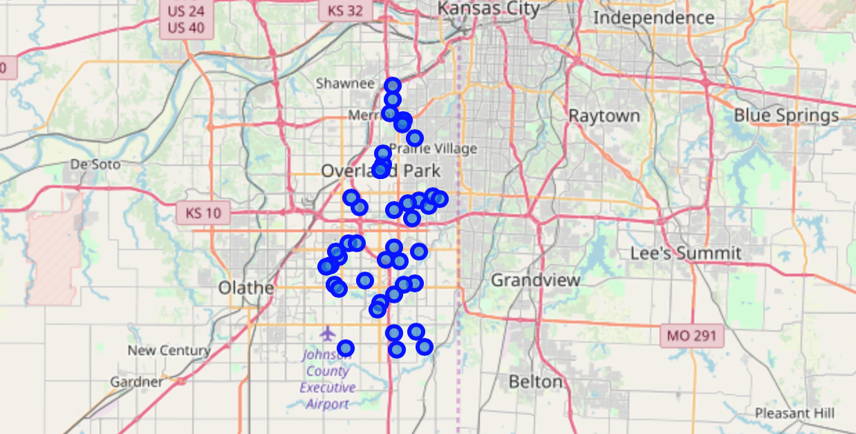
Exploratory Data Analysis
Visualize Overland Park with its Neighborhoods on Map

Slide 10
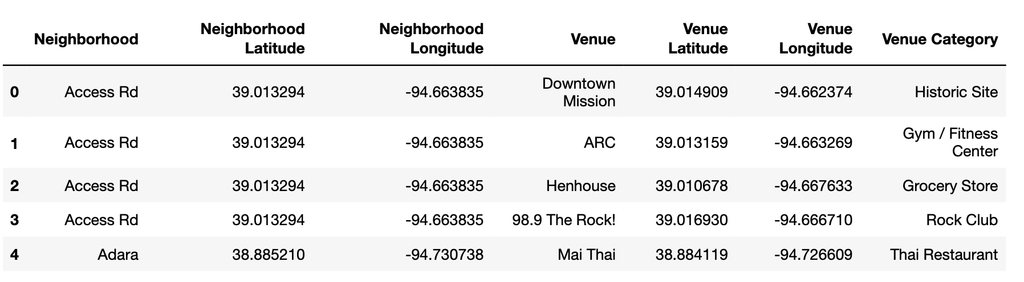
Exploratory Data Analysis (continued)
Sample neighborhoods with venues info and geo coordinates

Slide 11
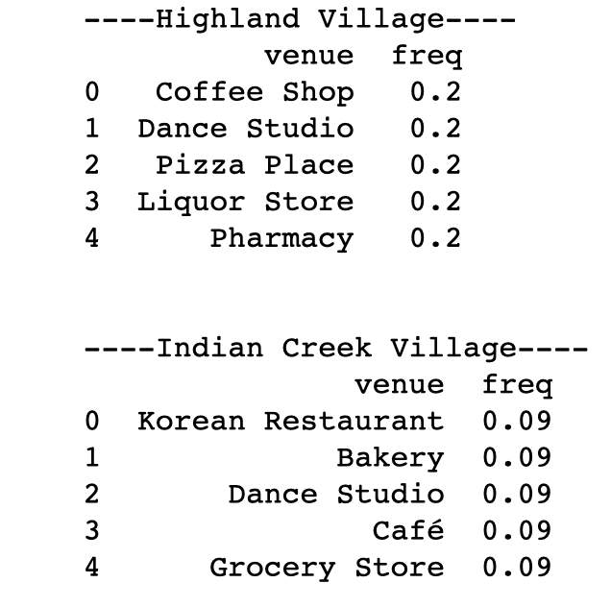
Exploratory Data Analysis (continued)
Two Sample Neighborhoods and Their Top 5 Most Common Venues

Slide 12
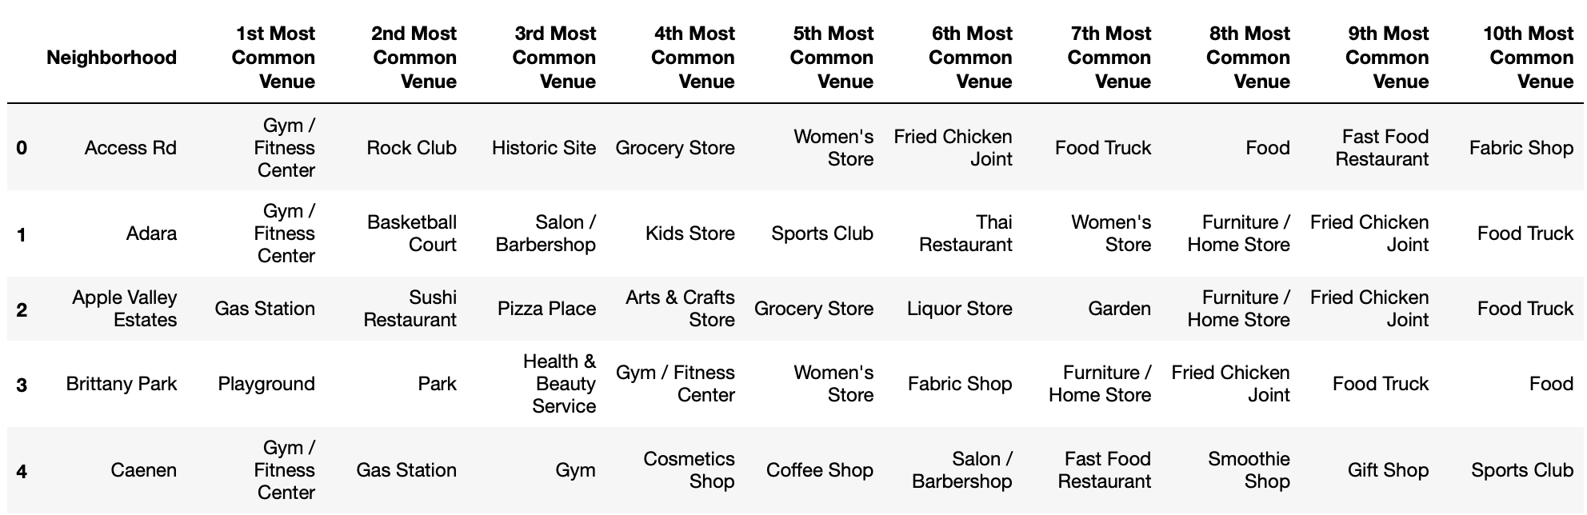
Exploratory Data Analysis (continued)
First 5 Rows of the Dataframe with Top 10 Most Common Venues in Each Neighborhood

Slide 13
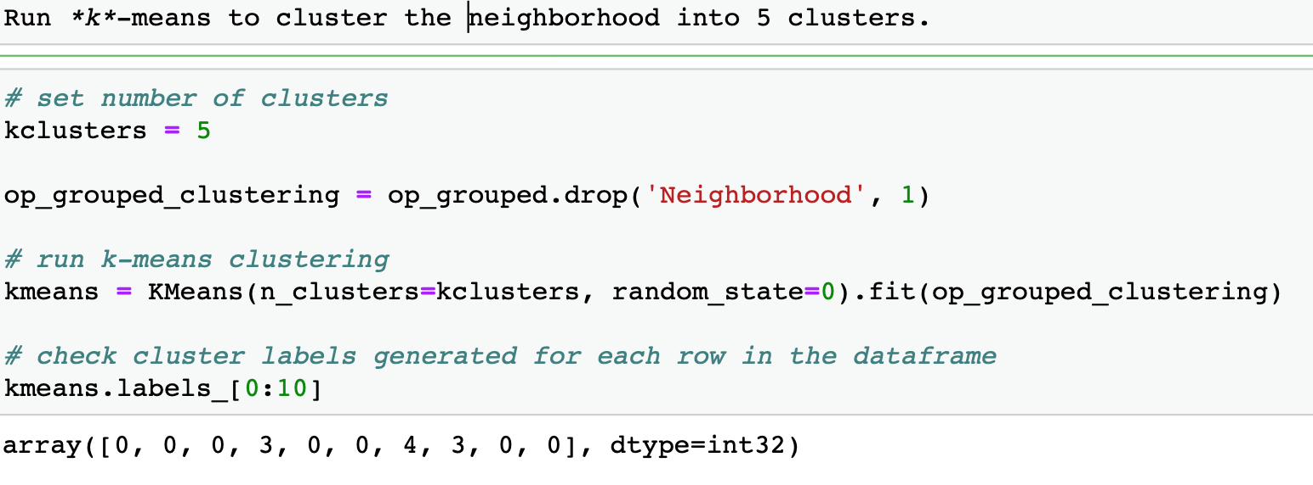
K-means Cluster
A Form of Unsupervised Machine Learning
Neighborhood Venues are Unstructured and Unlabeled data
K-means to 5 Clusters

Slide 14
Results
K-means clustering provided 5 clusters
Cluster 1: Living Haven
Cluster 2: Pizza and Shopping Haven
Cluster 3: Refill Haven-Both Human and Cars
Cluster 4: Leisure Haven
Cluster 5: Happy Hour Place

Slide 15
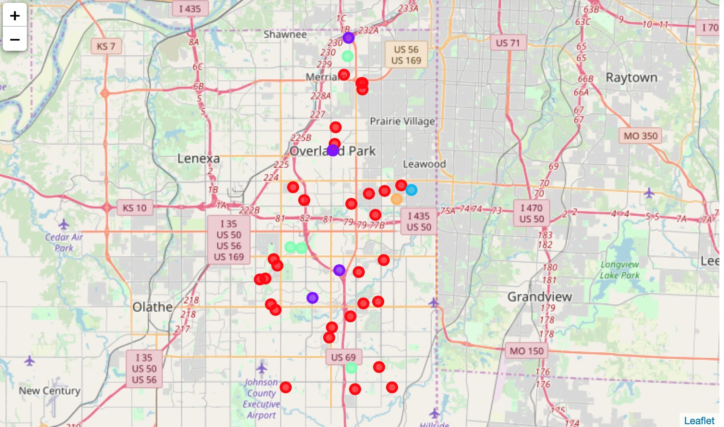
Results (continued)
Neighborhood 5 Clusters on Map

Slide 16
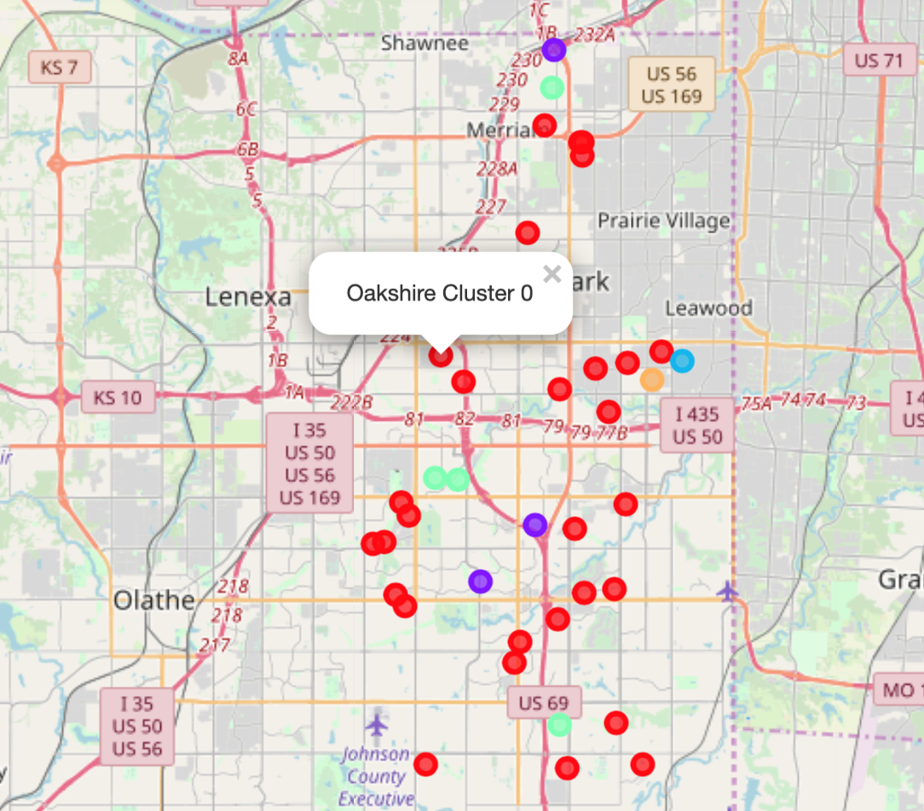
Results (continued)
Sample Neighborhood in Cluster 0 Popup on Map

Slide 17
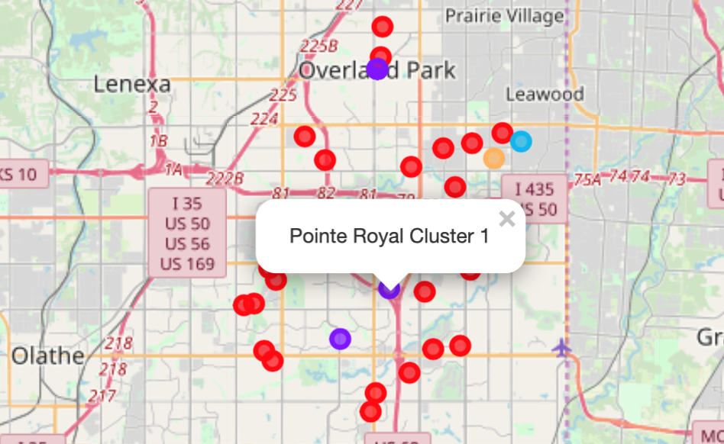
Results (continued)
Sample Neighborhood in Cluster 1 Popup on Map

Slide 18
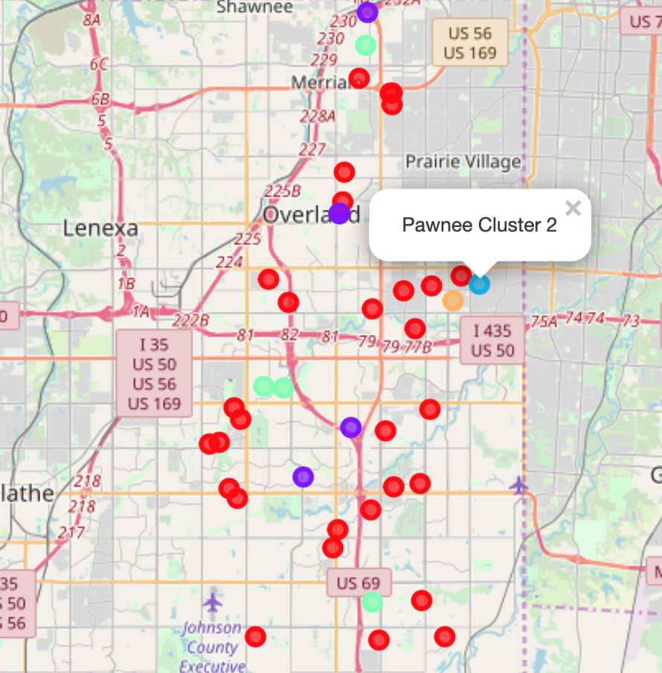
Results (continued)
Sample Neighborhood in Cluster 2 Popup on Map

Slide 19
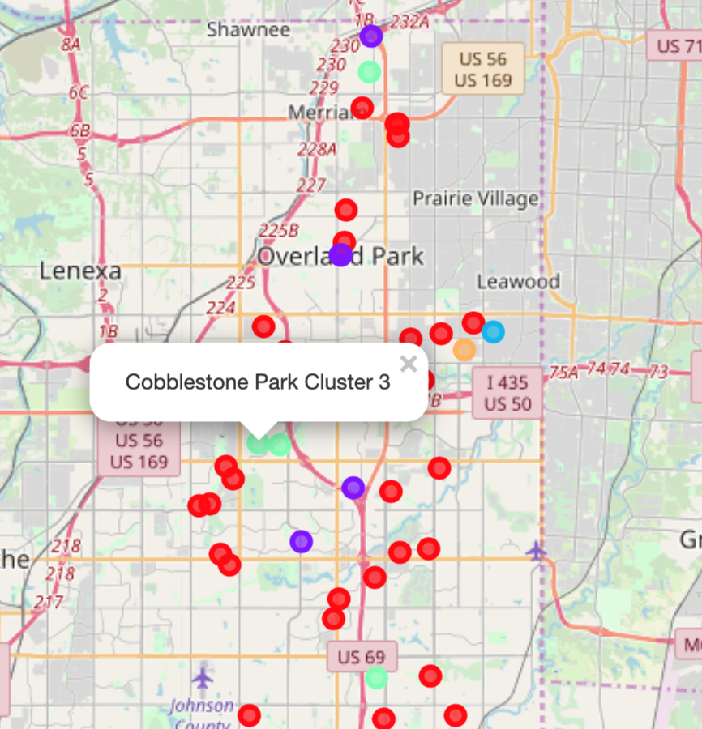
Results (continued)
Sample Neighborhood in Cluster 3 Popup on Map

Slide 20
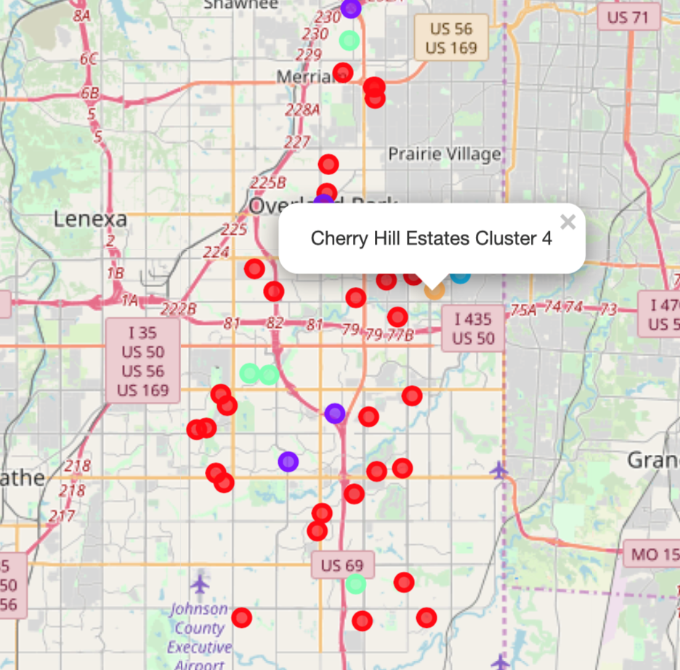
Results (continued)
Sample Neighborhood in Cluster 4 Popup on Map

Slide 21
Discussion
134 unique categories of venues in Overland Park
Most neighborhoods in Overland Park fall into clusters 1 and 2, with cluster 1 as Living Haven, which pretty much has access to all living related venues; while cluster 2 is a Pizza and shopping Haven.
With cluster 3, you eat at restaurants and fill the car tank conveniently too.
For cluster 4 and 5, I label them as Leisure Haven and Happy Hour Place since its top venue is Bar.
Neighborhoods scattering all around Overland Park belongs to cluster 0, which I labeled as Living Haven

Slide 22
Conclusion
The analysis provided insights and evidence to answer the question why Overland Park shows up frequently on the top list of best places to live in US.
I get to know my city better and know that many neighborhoods in it are just like mine, a Living Haven.
Hope this study would be able to provide local business evidence support to attract more talents to Overland Park and anyone who may explore the possibility to move to Overland Park.

Slide 23
Future Study
Explore trending venues around Overland Park. These are venues with the highest foot traffic at the time a regular call to the Foursquare API is made. This type of study and analysis may provide insights to developing trends thus may reveal some business opportunities in Overland Park.

Slide 24
References and Resources
Nextdoor website: https://nextdoor.com/city/overland-park--ks/
https://www.crummy.com/software/BeautifulSoup/bs4/doc/
https://geopy.readthedocs.io/en/stable/
Foursquare.com: https://foursquare.com/
JupyterNotebook: https://jupyter.org/
https://www.opkansas.org/
https://en.wikipedia.org/wiki/Overland_Park,_Kansas

Slide 25
Acknowledgement
Thanks to my family for their full support during the study of these data sciences courses and as always
Thanks go to all the instructors of these courses for their clear and informative video classes and hands on labs
I also deeply appreciate all the co-classmates of these courses for their timely grading of my assignments and positive feedback

Slide 26
Q & A
My JupyterNotebook:
https://github.com/sunflowerhub/Coursera_Capstone/blob/master/theOPneighborhoods.ipynb
My full report:
https://github.com/sunflowerhub/Coursera_Capstone/blob/master/capstoneProjectFinalReport.pdf

